Slide 1
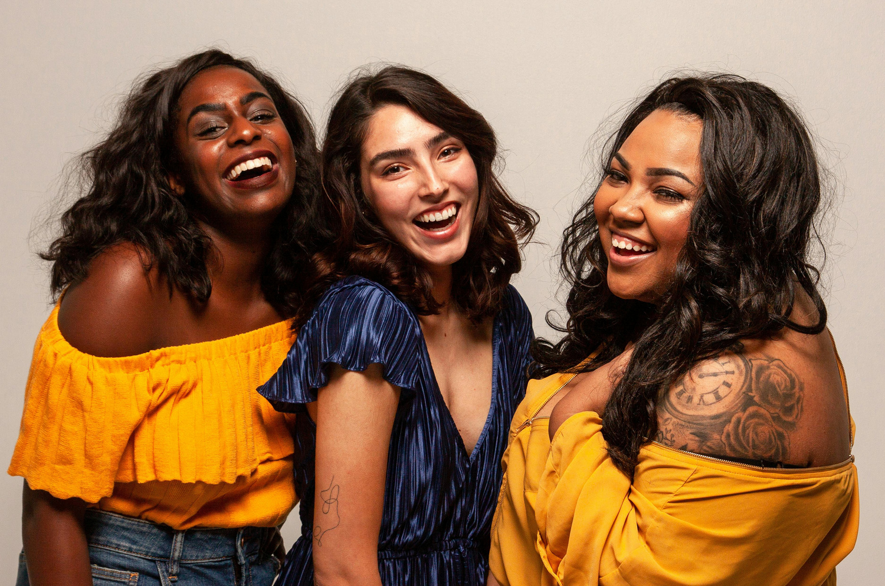
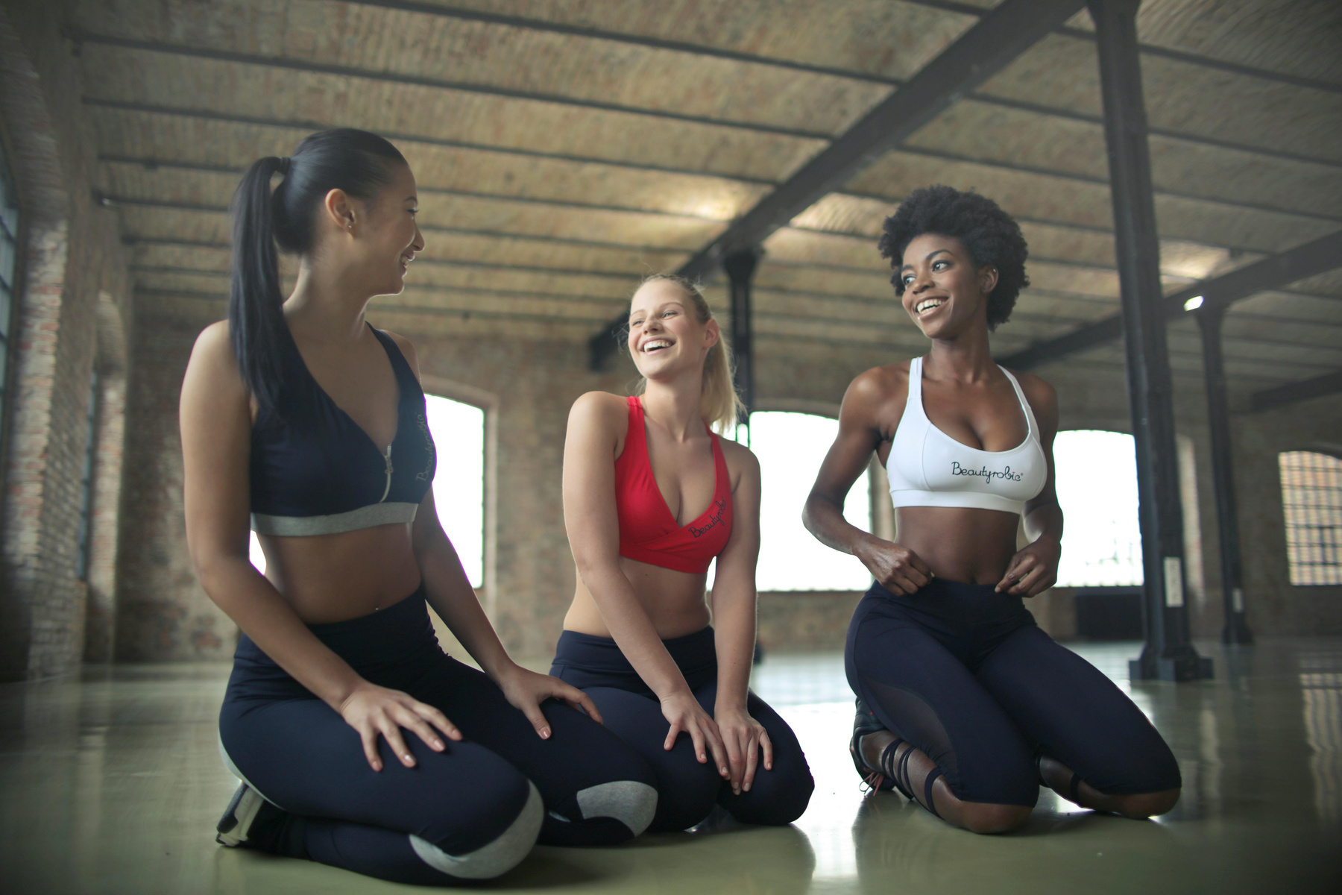
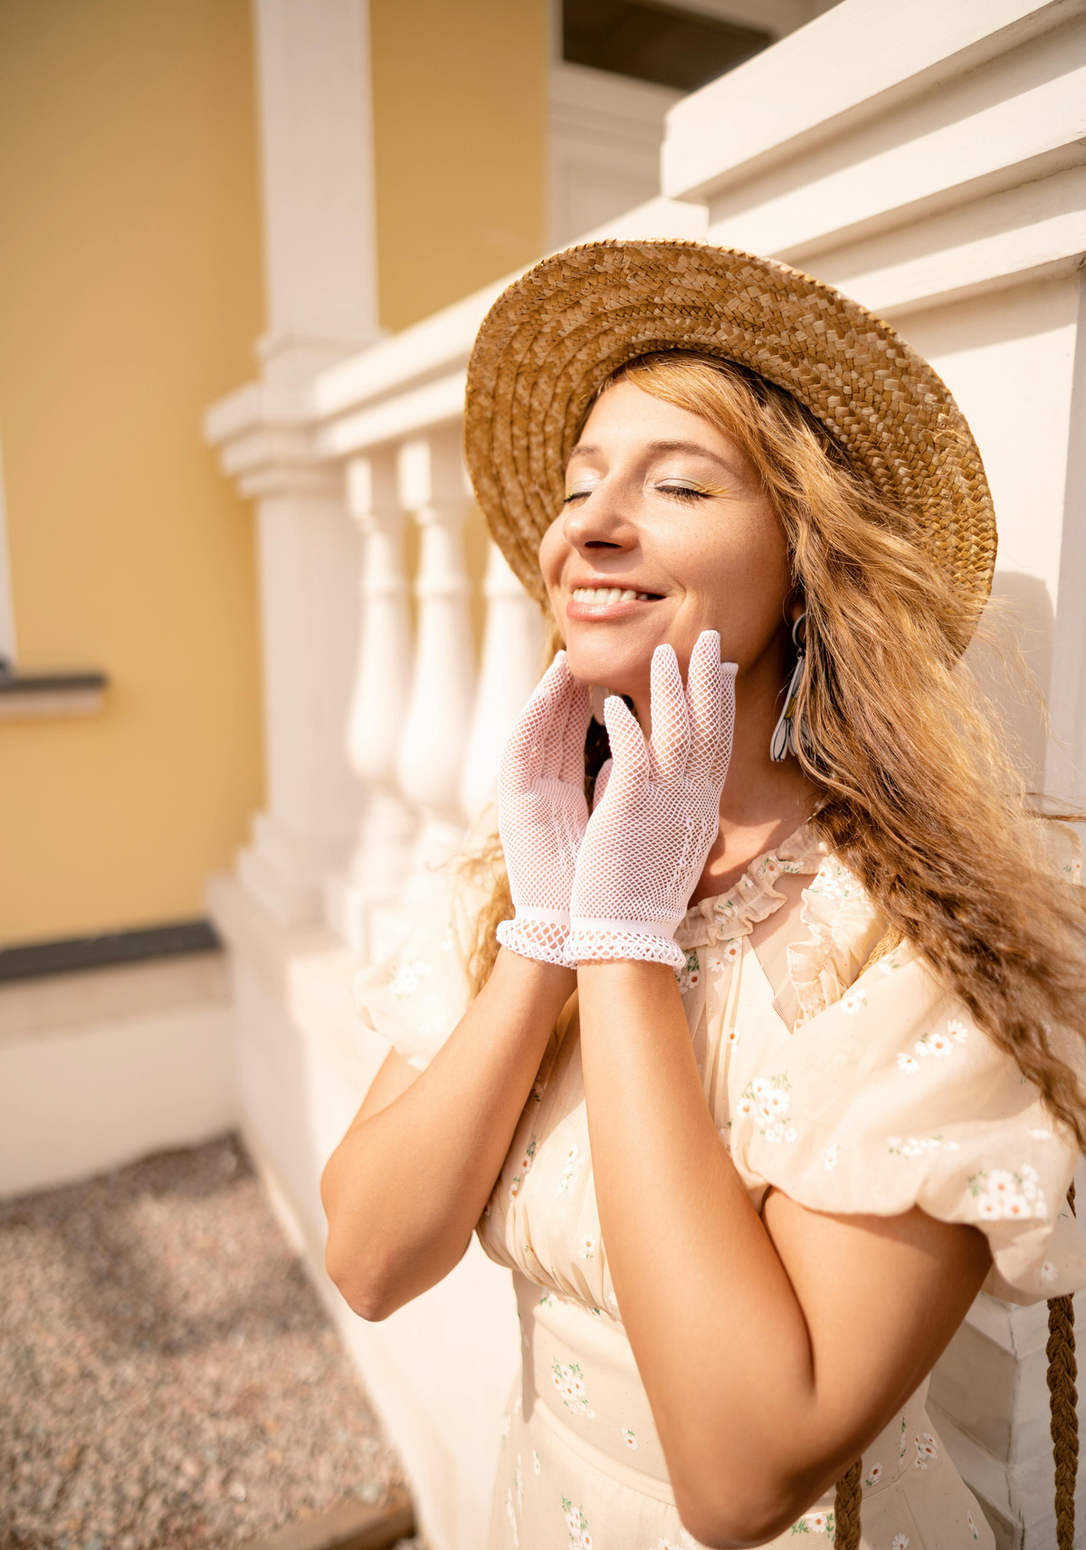




Slide 2


Slide 3
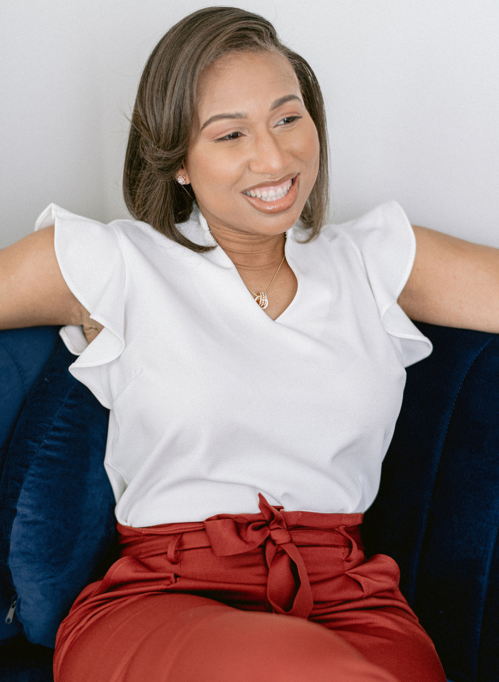
The Refreshing SMILE Retreat
Christi Venable

Slide 4
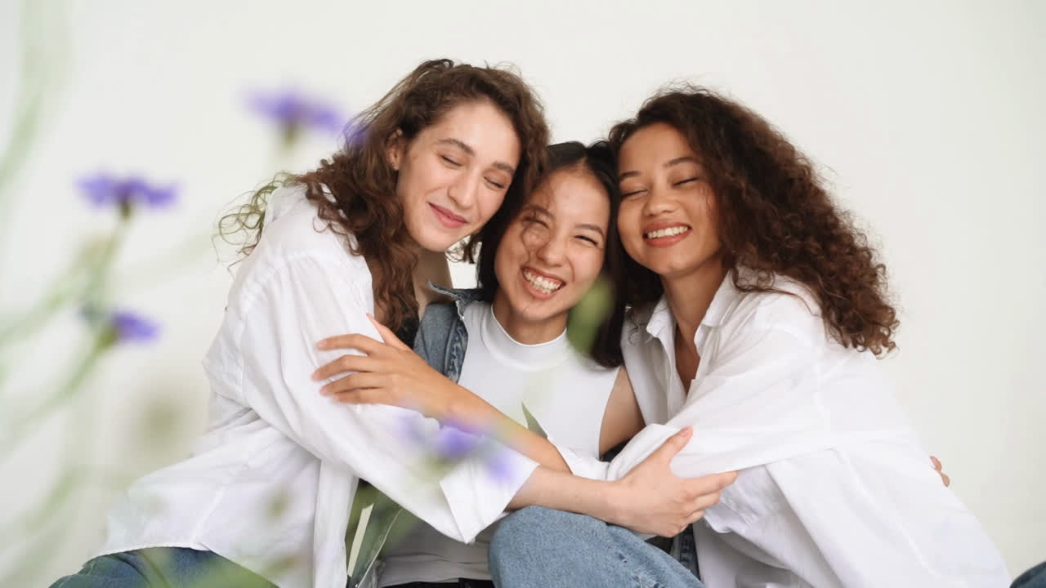
SMILE Therapy Services is a mental health and wellness consulting firm dedicated to providing preventative mental health and wellness services to corporations, organizations and individuals.
Our staff consist of seasoned licensed mental health professionals who are certified in providing trauma informed culturally competent services.
Our work helps to improve psychological safety in workplaces, increase retention by improving employee mental health and train leaders to lead the whole person.
Who We Are?

Slide 5
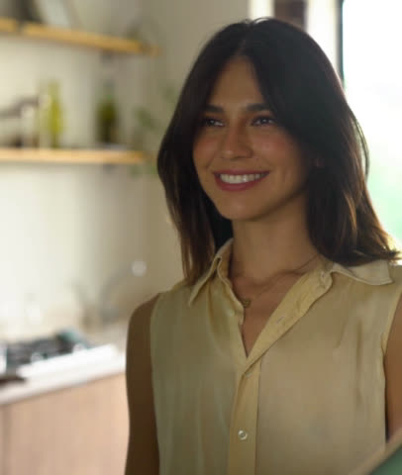
Our Mission
SMILE is committed to improving the lives of youth and adults by providing preventative quality trauma informed and culturally responsive mental health services through direct therapy, program management, educational workshops, and mental health trainings.
Our mission is to assist youth and their families who struggle behaviorally, socially, and emotionally to become self-sufficient contributing citizens to society.
We also are on a mission to ensure mental health is infused in the workplace by providing preventative mental health solutions and leadership development through a social emotional lens to managers and executives.

Slide 6
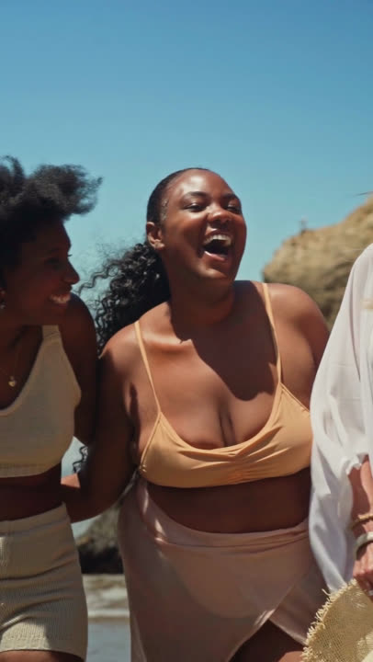
WE NEED YOUR HELP

Slide 7
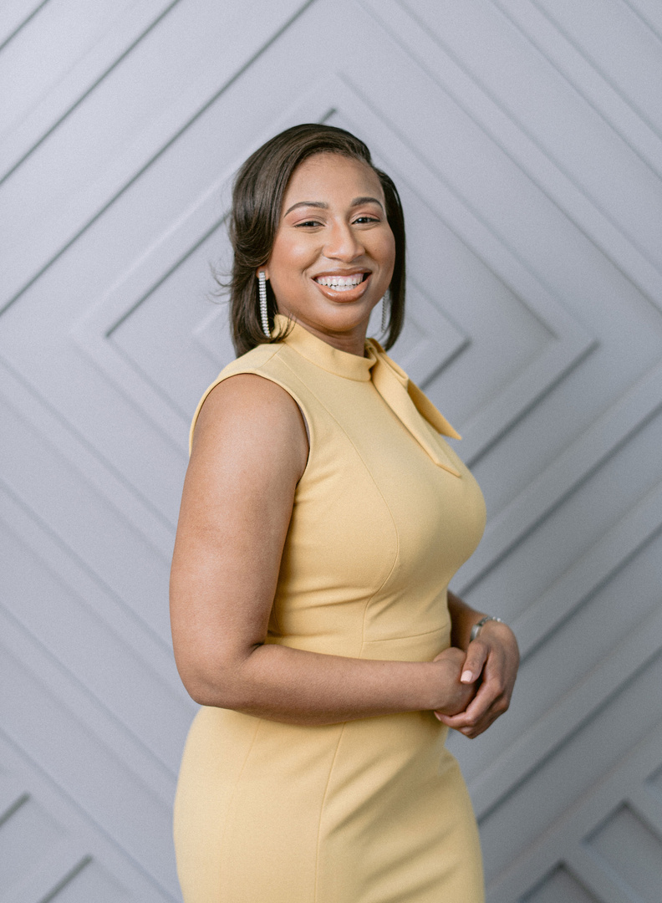
SPONSOR US...
Elevate your mental health and wellbeing path with SMILE Therapy Services by joining our premier Inaugural Refreshing SMILE Experience, a wellness retreat designed with the unique needs of corporate leaders and entrepreneurs in mind, focusing on improving mental health and well-being.

Slide 8

IMMERSE YOURSELF
Indulge in a sound therapy session, thought-provoking panel discussions, delve into rejuvenating self-care wellness sessions such as our immersive candle making workshop and poignant grief and loss experiential.
Explore an array of transformative wellness offerings from our esteemed vendors, available for purchase throughout the duration of the event. Network with like-minded professionals, and discover a wealth of enriching experiences designed to empower and inspire.

Slide 9

Title Sparkle Sponsor- $15,000
  Logo on all branding (printed marketing materials, social media, onsite banner, website, promotional items).
  2 branded items included in the swag bag.
  Vending space included if desired.
  Full-page ad in the retreat brochure.
  Special shoutout on social media and during the retreat.
  Speaking opportunity during the retreat.
  3 VIP tickets to the retreat.

Slide 10

Platinum Radiance Sponsor - $10,000
  Logo on all branding (printed marketing materials, social media, onsite banner, website, promotional items).
  1 branded item included in the swag bag.
  Vending space included if desired
  Full-page ad digital ad space
  Special shoutout on social media and at the retreat.
  2 VIP tickets.

Slide 11

Gold Glow Sponsor - $5000
  Logo on selected branding (printed marketing materials, social media, onsite banner).
  Vending space included if desired
  1 branded item included in the swag bag.
  Full page digital ad space
  2 General admission tickets

Slide 12
Silver Shine Sponsor - $2500
  Logo on digital marketing material.
  1/2 page digital ad space
  Vending space included if desired
  1 branded item included in the swag bags.
  1 general admission ticket.

Slide 13

Bronze Harmony Sponsor- $1000
  Logo included on all digital marketing material
  1/4 page digital ad space
  Vending Space included if desired
  1 general admission ticket

Slide 14

Partner - $500
  Logo included in retreat brochure
  1-general admission ticket
  Company Name in digital ad space

Slide 15
LET’S MAKE A DIFFERENCE

Slide 16

Become a sponsor today.
Contact LaShonda Marshall at:
lmarshall@smiletherapyservices.com
OR checkout and select your support level in the QR CODE BELOW
SPONSOR LEVEL

Slide 17

THANK YOU!

